Slide 1




Block Party!
Saturday
Neighbors List
Charlie Dey
Marcus Golden
Andy Qui Le
VOTE
Nove
Your voice matters!
Faiz Ikramulla
Lena DS
Parker Broadnax
Ayomide Okuleye

Slide 2





1 2 3
Meet the Neighbors
Andy
Qui Le
Lena Duplechin Seymour
Faiz Ikramulla
Parker Boradnax
Ayomide Okuleye

Slide 3



Git hub
https://github.com/le-n-qui/redistricting_sesame_street/tree/main

Slide 4


Mentor’s Pitch Scope
1 2 3
We're going to code up a simulation of voters and district
them and find the ideal. Then "gerrymander" the voting
districts to see how that affects voting.

Slide 5

Project Plan
1 2 3
Real data: Show some districts are unfairly bounded
Simulation to show unfairly bounded districts
Simulation to redraw districts
Real Data: Show this new simulation has potential real world application

Slide 6
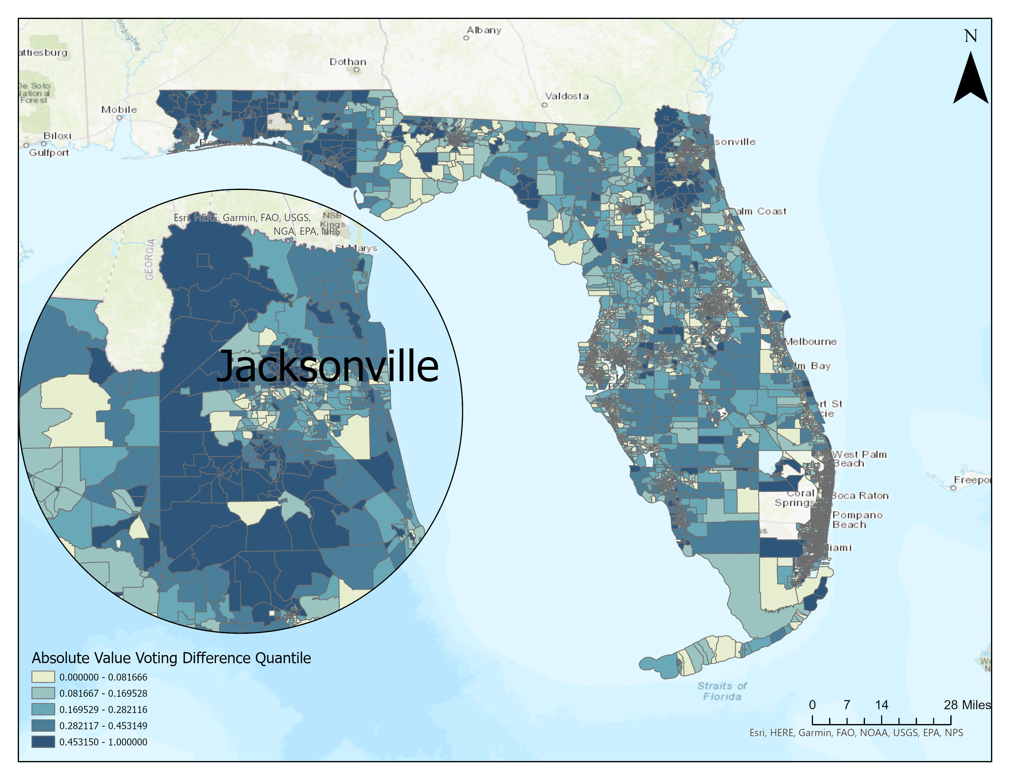
Why Florida?
1 2 3
Data Choices and Sources
Open public access laws
History of gerrymandering
Swing state
Data set has multiple rounds of verification from trusted sources

Slide 7
1 2 3
What We Learned
What gerrymander is and its impacts in voting rights
Matplotlib coordinated formatter, BigQuery, Jupyter Notebooks, GitHub, and Google Cloud usage
Gained more familiarity with python and classes

Slide 8
1 2 3
What We Accomplished
5 simulations of districting and voting
7 maps of districting Florida

Slide 9
1 2 3
Where We didn’t Succeed
Integrating simulation into GIS due to limits of manual polygon editing
Finding a single solution, many potential options

Slide 10

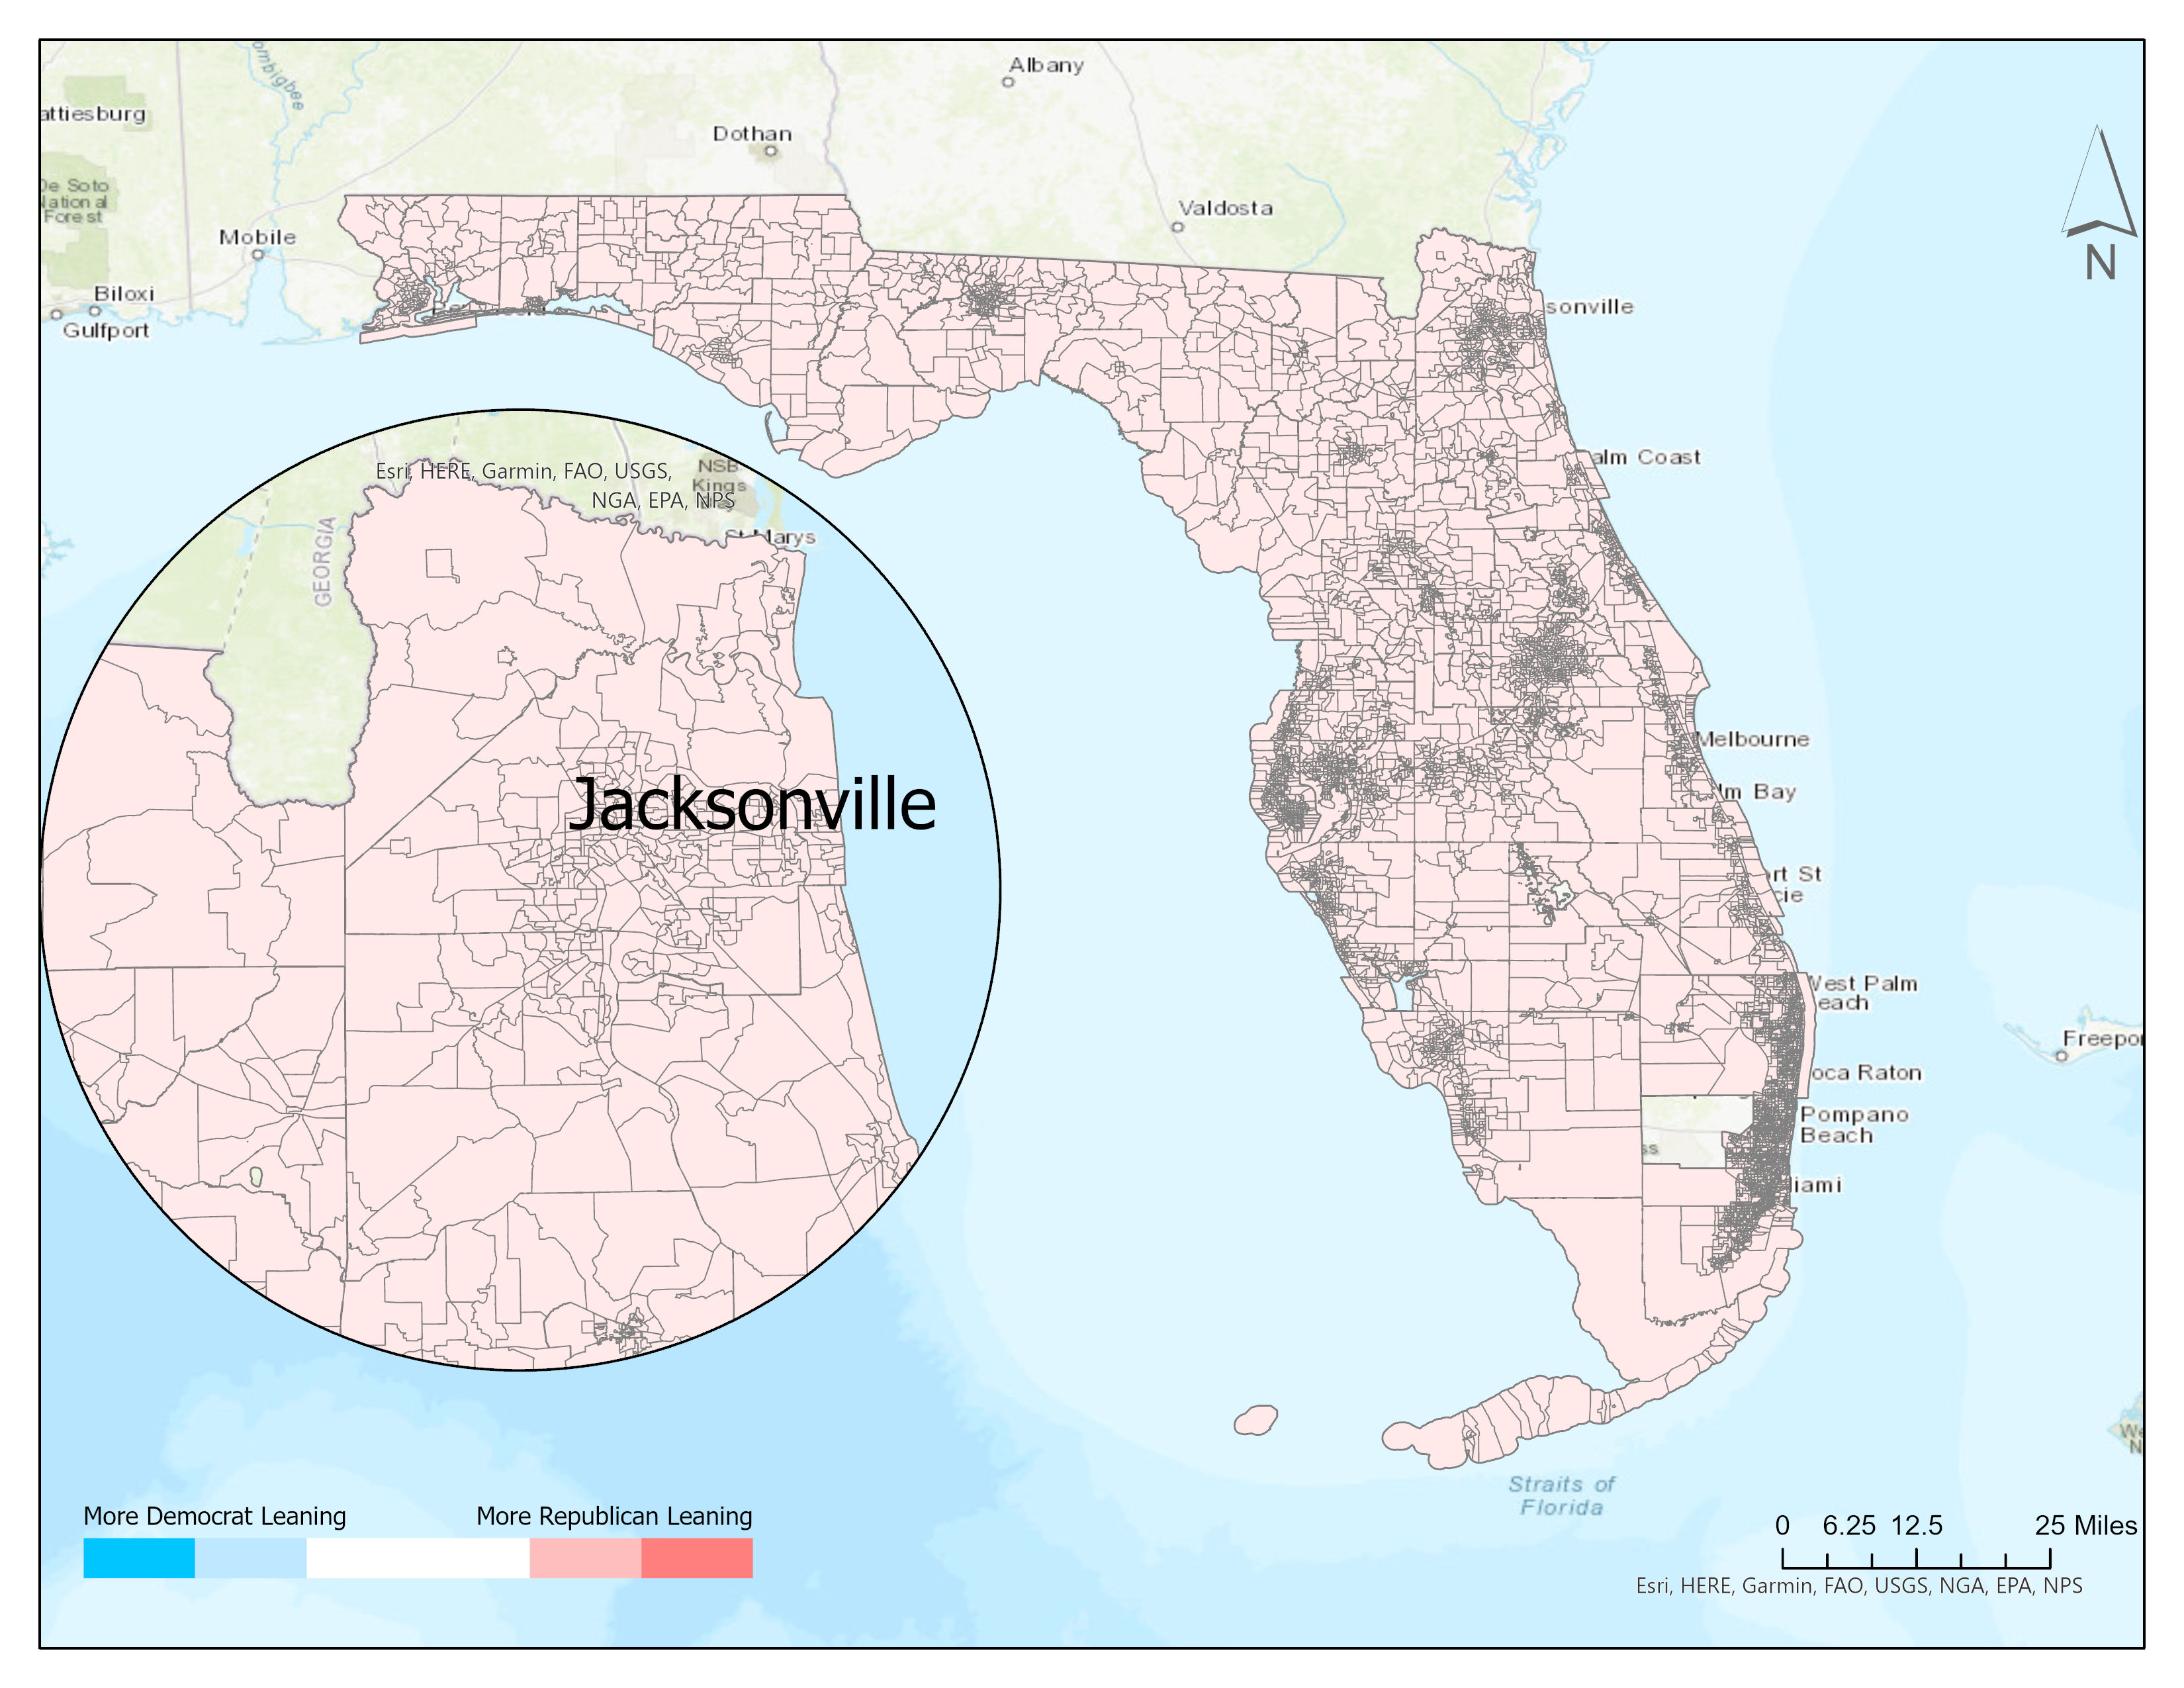
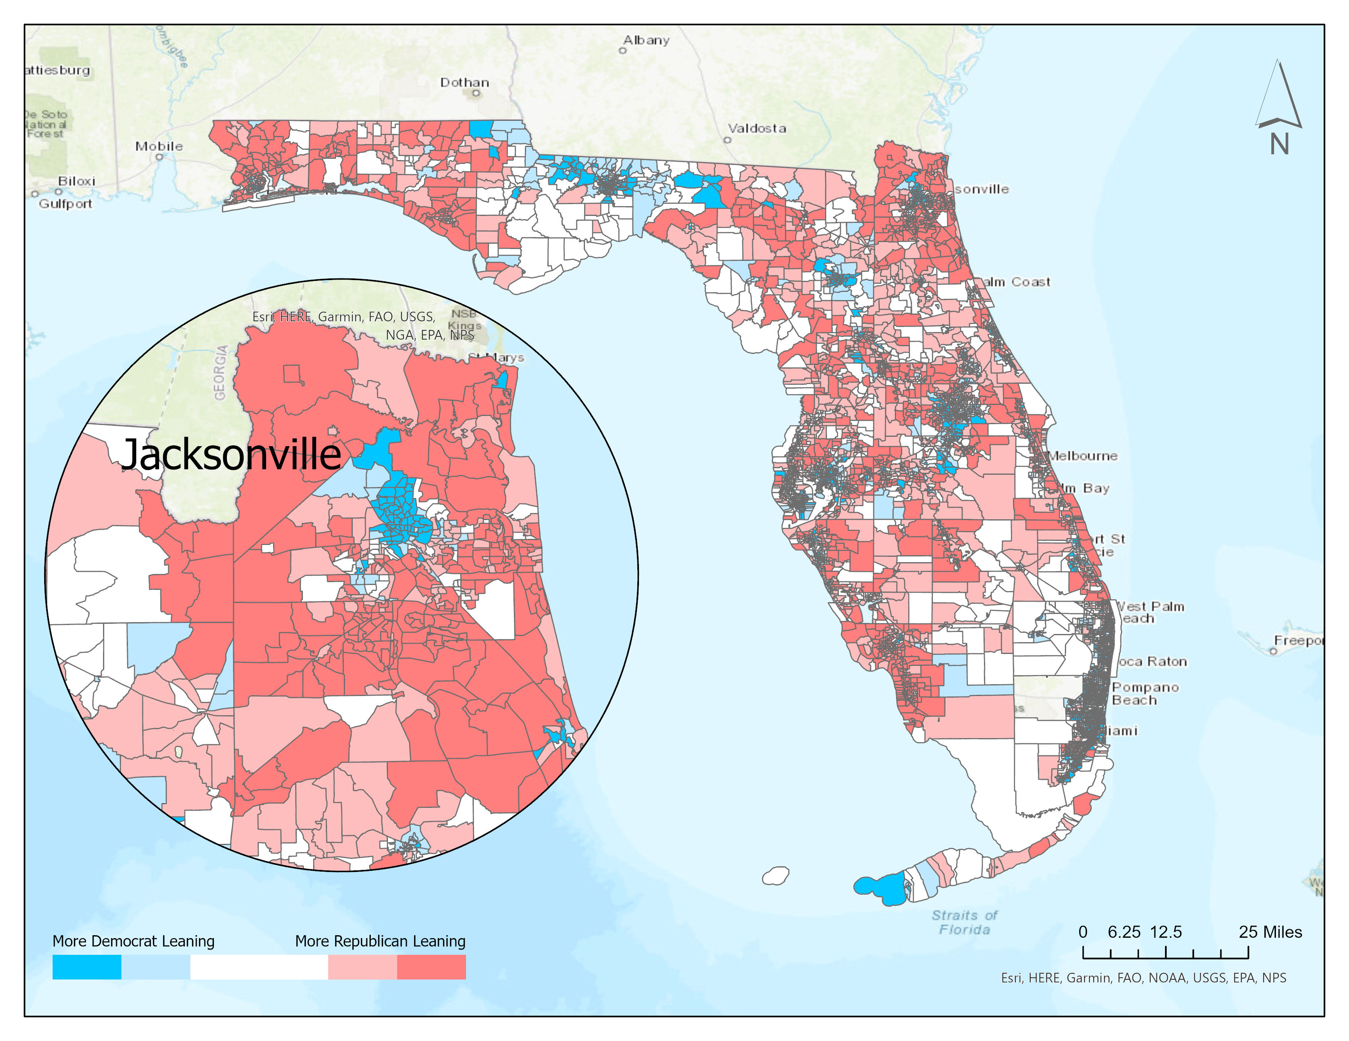
GIS Deliverables
Series of 2 maps
Real 2010 district results
Real state wide results

Slide 11
GIS Deliverables Side by Side

Slide 12
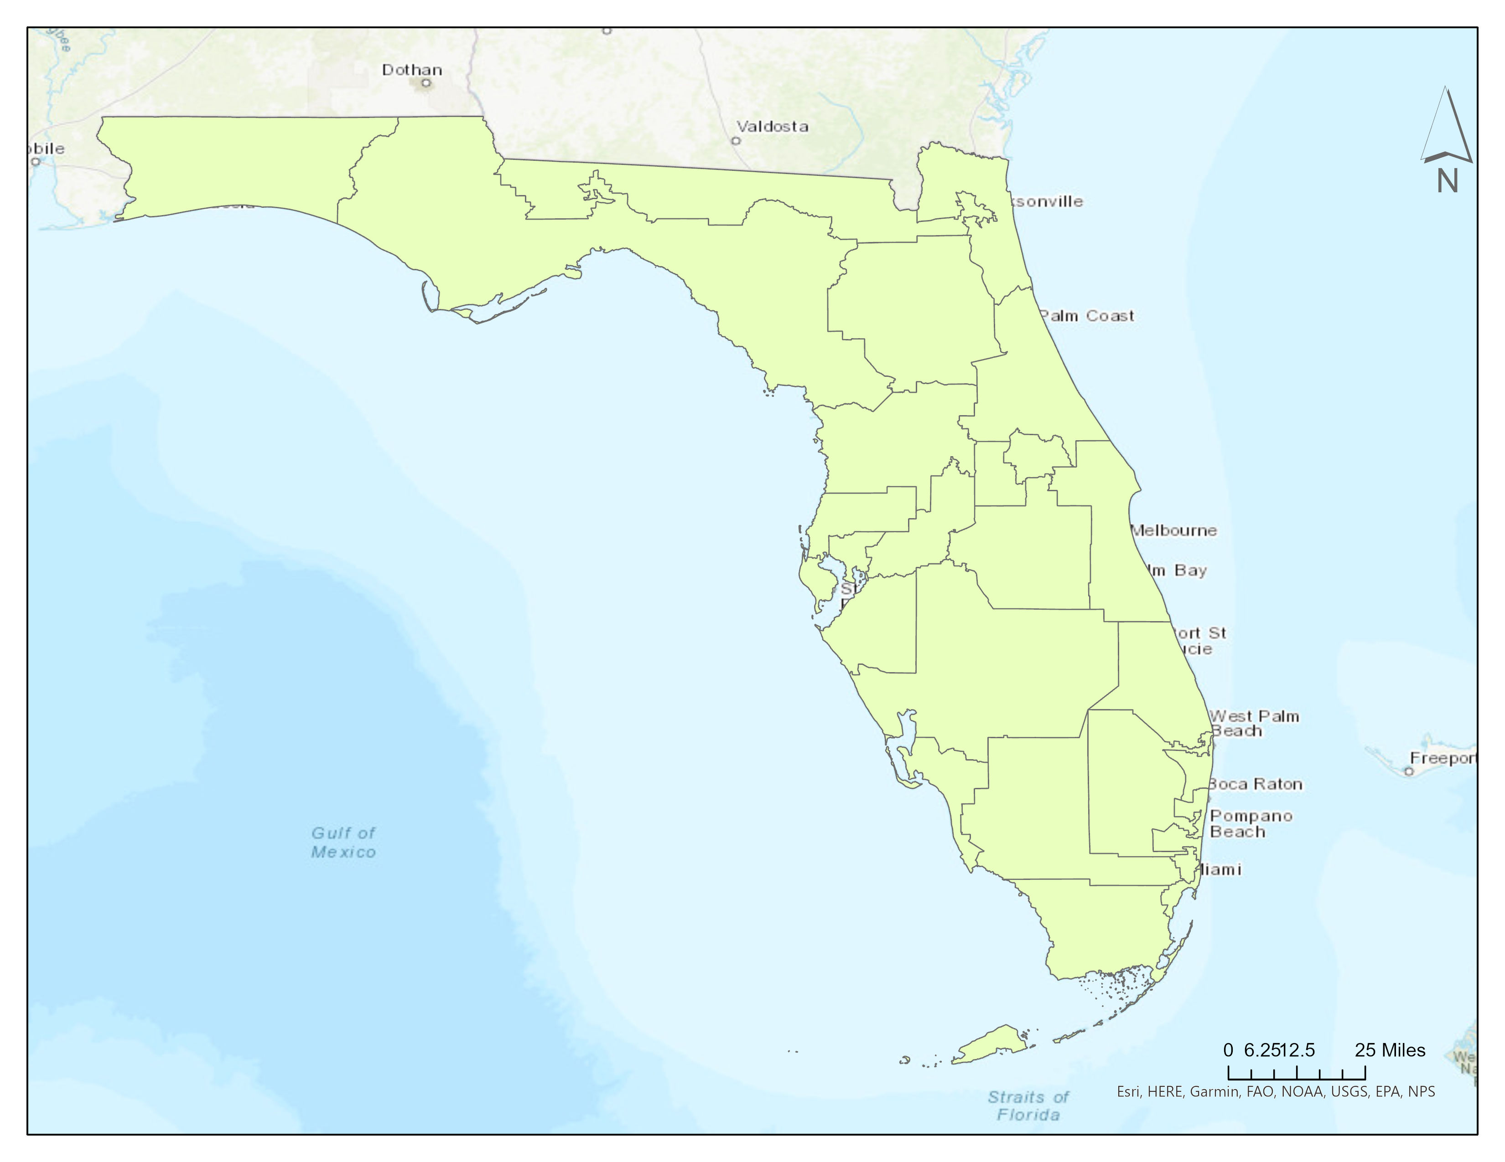
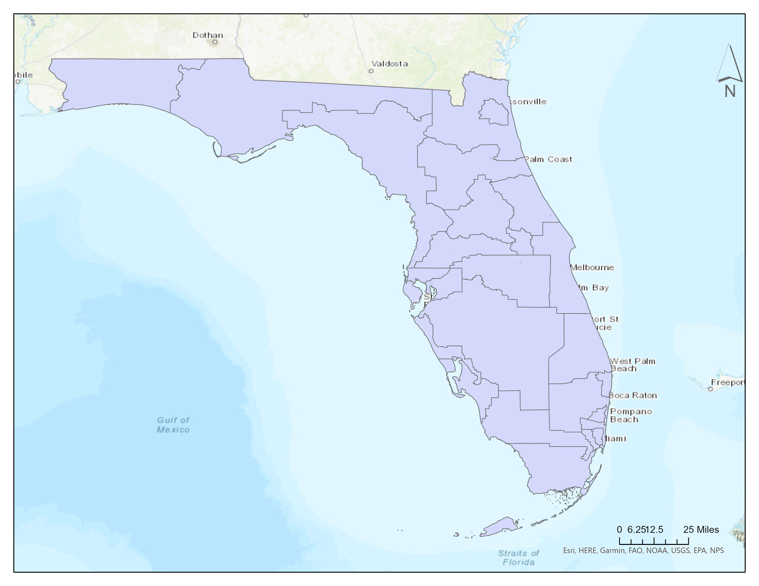
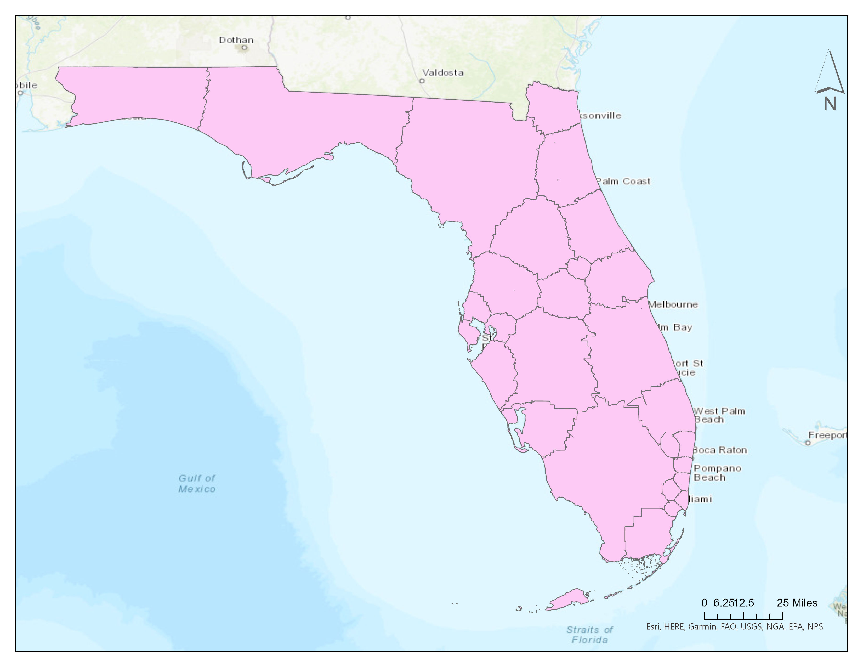
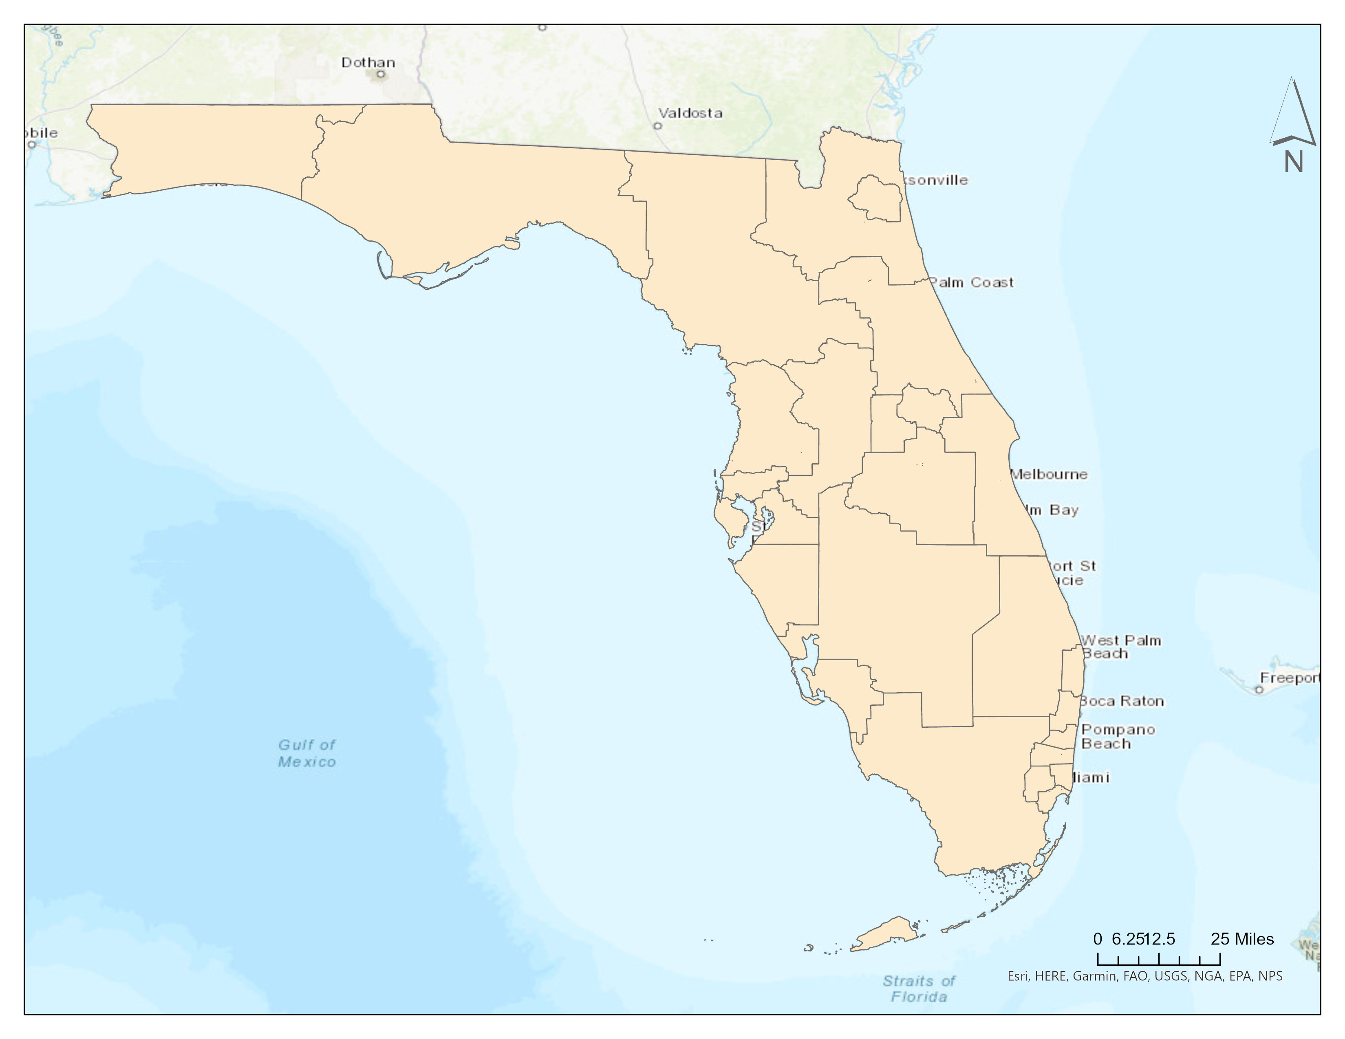
GIS Deliverables
Series of 4 maps
Theoretical options with less gerrymandering
Algorithmic Districts
Compact Districts
Competitive Districts
Current Districts

Slide 13
GIS Deliverables Side by Side
srfgsrsefsef
Algorithm Districting
Compact by County Districting
Competitive Districting
Current Districting

Slide 14
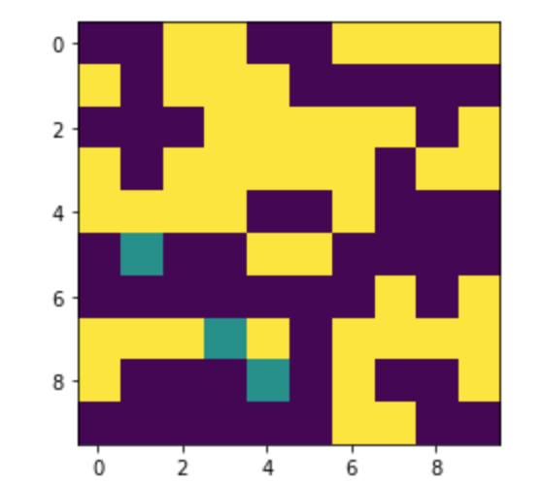
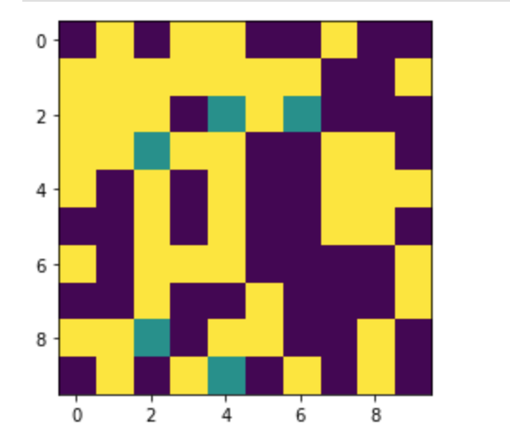
Graph Deliverables
2D representation of communities in a single simulation using sequential split
2D representation of communities in a single simulation using step split method

Slide 15
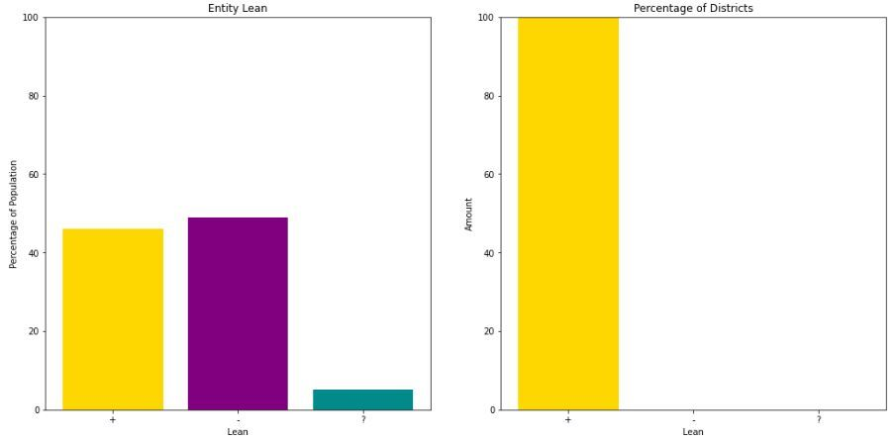
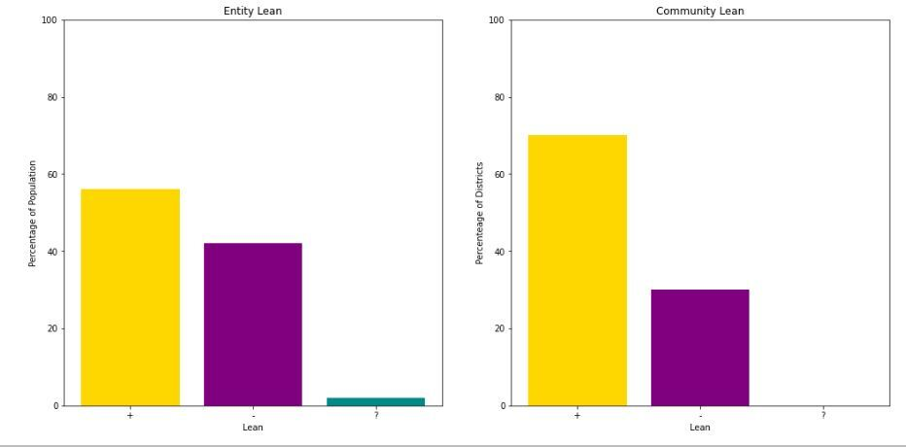
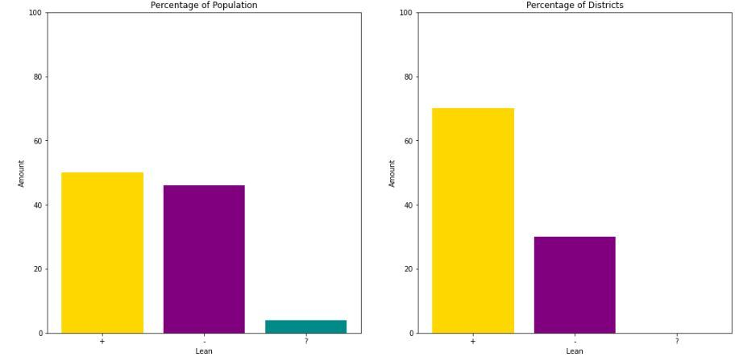
Graph Deliverables
Percentage of population compared to percentage of district leaning
Skewed districting plan
Fixed boundary districting plan
Random grouping districting plan
srfgsrsefsef

Slide 16
1 2 3
Future Work
Python script (Arc.py) to redraw polygon shape files in GIS
Web site and app that shows data visualization including interactive features
Change code to be 3D instead of 2D
Interactive map with hover facts

Slide 17
Demo

Slide 18





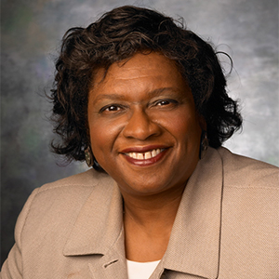


1 2 3
Thank you
Charlie Dey
Rich Asay
Marcus Golden
Amy Cameron
Josh Kissel
Linda Hayden
Alexander Nolte
Je’aime Powell

Slide 19






















1 2 3
Thank you

Slide 20
Data and Coding Help Sources
Harvard Election Data Archive http://dataverse.harvard.edu/dataset.xhtml?persistentId=hdl:1902.1/1679
Coding Help Sources https://docs.python.org/3/library/random.html?highlight=random#module-random
Programming project: Redistricting https://pages.tacc.utexas.edu/~eijkhout/resources/nifty/EijkhoutISPproject-gerry.pdf
Berkley doc https://people.eecs.berkeley.edu/~landau/papers/redistrictingfinalpreprint.pdf
Gerrymandering by Jory Fleming https://www.arcgis.com/apps/Cascade/index.html?appid=53fdc467fbb74790bb6bfcf1375cfa1f
Cornell Policy Review: Rigging Elections http://www.cornellpolicyreview.com/rigging-elections-spatial-statistics-analysis-political-unintentional-gerrymandering/
The Atlas of Redistricting https://projects.fivethirtyeight.com/redistricting-maps/#algorithmic-compact
538 Redistricting Atlas Data https://github.com/fivethirtyeight/redistricting-atlas-data

Slide 21
Git hub
https://github.com/le-n-qui/redistricting_sesame_street/tree/main

